Slide 1
Component Diagram

Slide 2
Component Diagrams
UML component diagrams describe software components and their dependencies to each others
Models the physical implementation of the software (file resources)
Models the high-level software components, and their interfaces
We use component diagrams to model the static implementation view of a software system.
It is a type of structural UML diagram

Slide 3
What is a Component
Modular unit with well-defined interfaces that is replaceable within its environment
Autonomous unit within a system
Has one or more provided and required interfaces
Its internals are encapsulated, hidden and inaccessible
Its dependencies are designed such that it can be treated as independently as possible
The components can be a software component such as a database or user interface; or a hardware component such as a circuit, microchip or device; or a business unit such as supplier, payroll or shipping.

Slide 4
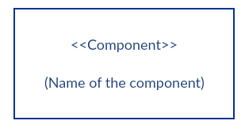
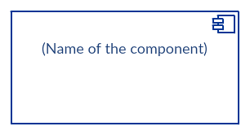
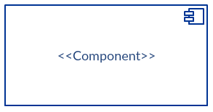
Component Notation
1) Rectangle with the component stereotype (the text <<component>>). The component stereotype is usually used above the component name to avoid confusing the shape with a class icon.Components can be labelled with a number of standard stereotypes
ex: <<entity>>, <<subsystem>>,<<table>>,<<library>>, etc
2) Rectangle with the component icon in the top right corner and the name of the component.
3) Rectangle with the component icon and the component stereotype.

Slide 5
Component Elements
1. Interfaces
An interface represents a declaration of a set of operations and obligations
2. Usage dependencies
A usage dependency is relationship which one element requires another element for its full implementation
3. Ports
Port represents an interaction point between a component and its environment
4. Connectors
Connect two components through interface.

Slide 6
INTERFACE
A component defines its behaviour in terms of provided and required interfaces
An interface
Is the definition of a collection of one or more operations
Provides only the operations but not the implementation
Implementation is normally provided by a class/ component
In complex systems, the physical implementation is provided by a group of classes rather than a single class
2 types
Provided Interface
Required interface

Slide 7
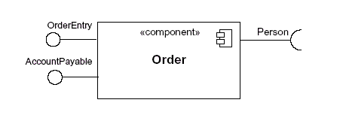
INTERFACE
Provided Interface
A component's provided interface describes the services provided by the component.
Is modeled using a ball, labelled with the name, attached by a solid line to the component
Required Interface
A required interface declares the services a component will need.
Is modeled using a socket, labelled with the name, attached by a solid line to the component

Slide 8

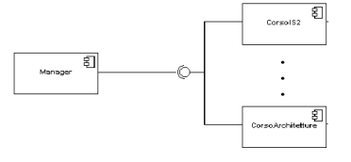
INTERFACE
Where two components/classes provide and require the same interface, these two notations may be combined
In a system context where there are multiple components that require or provide a particular interface, a notation abstraction can be used that combines by joining the interfaces

Slide 9
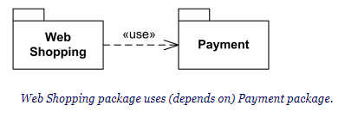
Usage Dependency
A usage dependency is relationship which one element requires another element for its full implementation
Is a dependency in which the client requires the presence of the supplier
Is shown as dashed arrow with a <> keyword
The arrowhead point from the dependent component to the one of which it is dependent

Slide 10
Port
Specifies a distinct interaction point
Between that component and its environment
Between that component and its internal parts
port may have visibility. When a port is drawn over the boundary of a component, then it means that the port is public. It also means that all the interfaces used are made as public.
When a port is drawn inside the component, then it is either protected or private.

Slide 11
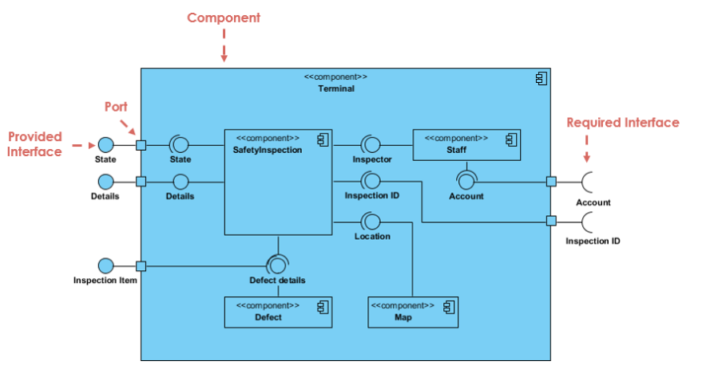

Slide 12
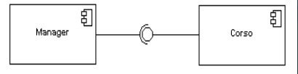
Connector
Two kinds of connectors:
Assembly
Delegation
ASSEMBLY CONNECTOR
A connector between 2 components defines that one component provides the services that another component requires
An assembly connector is notated by a “ball-and-socket” connection

Slide 13
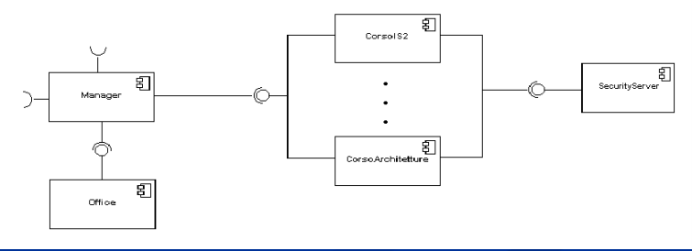
Multiple connections directed from a single required interface to provided interfaces indicates that the instance that will handle the signal will be determined at execution time

Slide 14
DELEGATION CONNECTOR
Links the external contract of a component to the internal component
Represents the forwarding of signals
It must only be defined between used interfaces or ports of the same kind

Slide 15
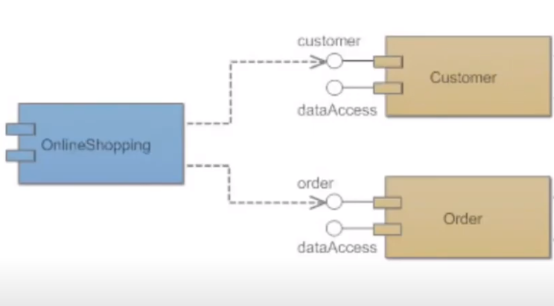

Dependency Relation
One component is dependent on data from another component
<<component>>
<<database>>
<<component>>
Here order and customer component depends on data from online shopping database

Slide 16
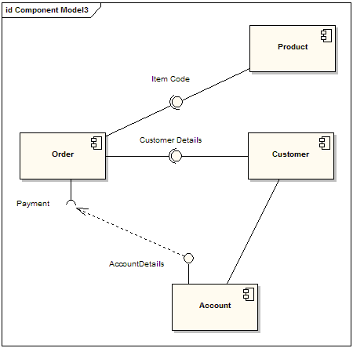
Here the payment interface depends on data from Account Component for it’s full implementation. The dependency maps a customer's associated account details to the required interface "Payment"

Slide 17
Where to use
To model the component of the system
To model source code
To model executable releases
To model physical databases
To model adaptable systems

Slide 18
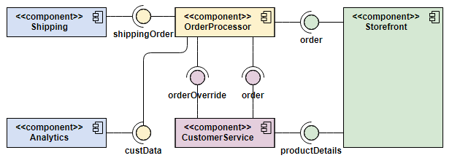
Order Processing System Component diagram example
Here the Storefront component
provides interfaces for Order and
ProductDetails. CustomerService
implements this interface as this
component needs access to
ProductDetails of the products available in storefront. Again CustomerService is able to order and override orders. All these operations are handled by the Orderprocessor component. Then this component provide Customer data to analytics component and shipping data to the shipping component

Slide 19
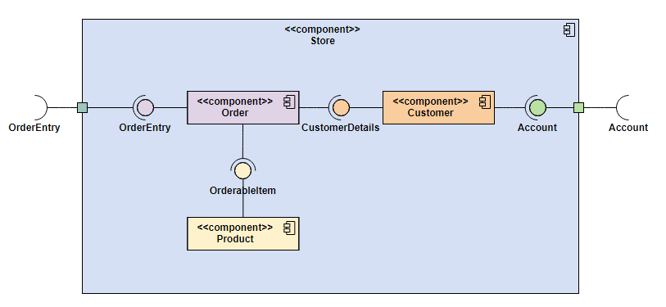
Nested Component Structure
Here the Store component has
some components inside it. In
such cases delegation connector
and port is used to pass signal
from external component to the
internal ones. Here we see that
Customer component requires the account and and Order component provides order entry related functionalities from an external component.

Slide 20
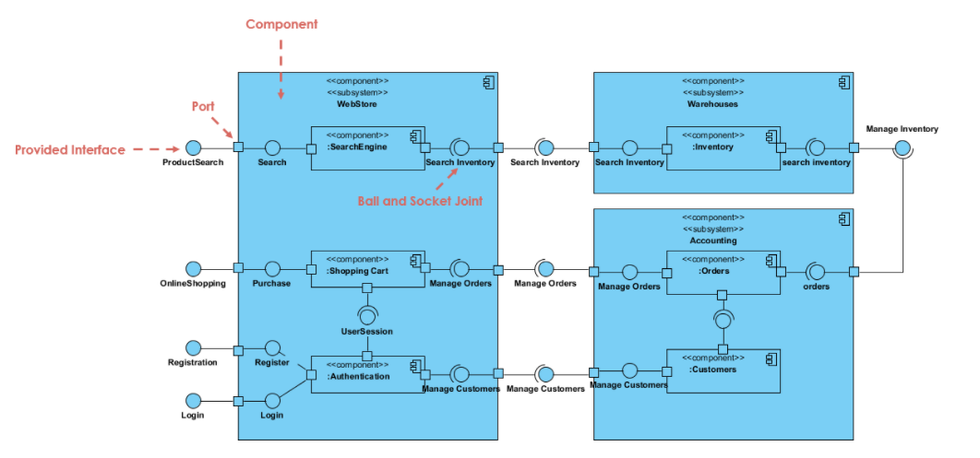
Some more examples

Slide 21
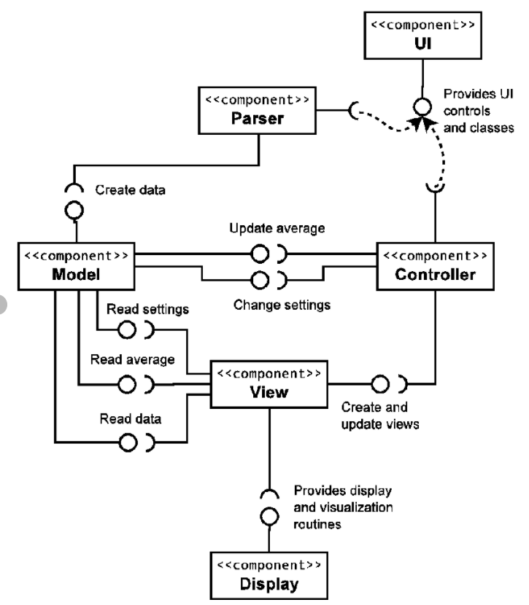

Slide 22
